Slide 1
My Humility
My Responsibility

Slide 2
My Humility
What do I understand by ‘Humility?’
Why is my Humility important?
How can my Humility help me?
Help can my humility help others?
How can my Humility help my relationships?
How can I become more humble?

Slide 3
My Humility
Who am I?
Why am I here?
Was I created or did I create myself?

Slide 4
My Humility
Who provides for me? Am I completely self-sufficient? Or do I depend on provision from that which is Higher than myself?
Do I earn my own living? How so? Did I create this opportunity for my own self?

Slide 5
My Humility
What gifts and talents do I have?
Is no one able to take these blessings away from me?
Were these gifted to me or did I create them?
How am I able to see and hear and understand?
How am I able to share my blessings?
Am I to be Praised for my opportunity to serve?

Slide 6
My Humility- my hands
With my own hands do I choose to create? Who do I create for? To provide only myself or to provide for others? Who gave me these hands?
Can I create something from nothing or am I only able to reshape something into something else?
How can my humility guide me to use my hands to show gratitude to, serve, Praise and Glorify my Creator?
How can my humility help me to use my own hands to bring justice and peace to the world through using them in Truth and for acts of loving kindness?
To whom do my hands belong? Are they My hands or the Hands of my Creator?

Slide 7
My Humility- my feet
With my own two feet do I choose to walk my own path? Why do I choose the paths that I choose? Where do I choose to travel to using my feet?
How does my humility help to guide my feet?
To profit for myself or to help others? Who gave me these feet? To Whom do they belong?
From where do the materials come from that I use to make my shoes? Do I grow them from the ground?
Did I create the gravity that connects me to the earth’s surface? How can my humility help me become more grounded?
How can my humility guide me to gratitude to my Creator- by choosing to use my feet to travel along paths that serve Him and Seek Truth and Justice?
How can my humility give me the courage I need to use my feet to walk the narrow paths into the Unknown –in search of wisdom and understanding- through the dark valleys of the shadow of death?

Slide 8
My Humility- my eyes
With my own eyes do I choose to see the world around me? What do I choose to look at? What do I choose to Read? And why? - To pleasure myself or to better myself?
Do I use my eyes to help me to ponder in awe or to enable me to mock and judge?
Do I choose to see with my own eyes or with the eyes of that which is Higher than myself?
How can my humility help me to see and appreciate more the hidden wonders of my universe; that which is beyond and within my own capacity?
How can my humility help me to use my inner vision to help me get closer to seeing that which is beyond myself?
How can my humility help me to better see You with these eyes that I have?
To whom do my eyes belong? To me or my Creator?
Do I prefer to see the reflection of myself in the mirror or my reflection in You? How can humility help me escape from my own vanity so that I can have a better relationship with others?

Slide 9
My Humility
With my own ears do I choose to hear?
With my own heart do I choose to love?

Slide 10
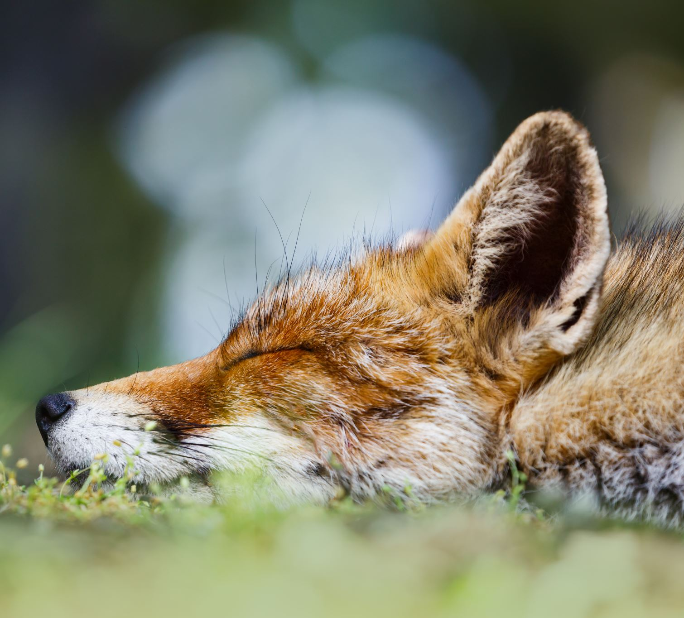
My Humility- My ears
Who gave me these ears with which I can hear? Did I make them? Did I speak them into existence? So how do I choose use my ears to help guide my own speech?
Do I expose my ears to hear gossip and idle talk that causes harm to myself and others? –If so why? Would I like that others heard these words that I choose to listen to- spoken about myself? Am I more worthy of my ears than the one who chooses not to slander me?
How can my humility help me to turn away from hearing words that cause destruction to myself and harm to others?
How can my humility help me become more creative with sound and speech?
Am I able to hear only that which is outside of me or can I hear the call of the caller from within me?
How can my humility help me to hear the sound of the silent shofar- the call of my Creator from my heart -so that I can return, so that I can hear and obey the Truth of my life and fulfil the purpose of my soul?
How can my humility help me become more able to hear You when you call on me for help? How can it help me reach out to you in your hour of need?

Slide 11
My Humility- my heart
Did I create my heart or is it a blessing from that which is Above me?
Did I make my heart beat or is it You that keeps me alive? Can I control the rate of my heart beat using my intelligence alone? Can I keep it beating when my time has come to die?
How can humility help me to purify my heart from the stains of the evil inclinations in my heart which lead to the spiritual death of my love?
How many hearts do I have- one or two? Where do I choose for my love to reside? In me or in You? In the physical or the spiritual?
How can my humility help me to find an eternal home for my love so that when my heart leaves this world- my love can live in the hearts of others?
Howe can my humility help me to Love my Creator with my heart and soul and strength, and my fellow human as myself?

Slide 12
My Humility- My digestive system
Am I so great that I do not need to relieve myself of harmful excretions? Where do my excretions go? Do they not return to the soil and dust of the earth from which I was made? How can my humility bring me back to earth through reflecting on my circle of Life?
Who am I that I need to eat and drink and sleep and digest? What is my Source of Provision? Am I my own provider? Am I my own Source of energy Source? So why am I so wasteful? How can my humility help me to become less wasteful?
Do I rely only bread and water for life? What provides me with the food that I eat and the water that I drink? How can my humility help me to become more grateful and express more gratitude to my Source of Provision by providing food and drink to those that are hungry and thirsty?
How can humility help me to realize that I am nothing more than human being that depends on input and output of energy in order to survive, live and grow?
How can my humility help me become more careful about what I choose to eat and drink? Do I become that which I eat? Or do I eat that which I become?
How can my humility help me to take in and digest the spiritual bread and water that feeds my soul, so that I can grow spiritually as well as physically into a fruit bearing tree that feeds others?

Slide 13
My Humility- my Liver
Did I create my liver or was it created from Above? Who does my liver belong to? Is it mine? If so- then do I look after it? Why do I have it? What am I supposed to do with it?
Do I cleanse my body from the toxins that enter into me? Or do I choose to let them enter and destroy my life? Am I working for or against my body? Do I have the ability to help my body cleanse itself from physical and spiritual impurities? If so- how?
How can my humility help me to use my free will to the best of my ability to take responsibility and better care of my own wellbeing? How can it help me to look after and protect the space in which I need to heal and repair myself?

Slide 14
My Humility- my sexual organs
Who gave me my reproductive organs with which I can procreate? Did I create my ability to procreate or is it a blessing from Above?
Who gave me a spouse with which I can unite in marriage? With my own sexual organs do I choose to reproduce? Do my children and spouse belong to me or to my and their Creator?
How can my humility help me to better control my lust so that I can choose and pursue a path of Unity over division using my sexual organs?
How can my humility help me to refrain from my desire to control others so that I can have a better relationship with my partner: in respect and selfless love while giving them space to grow?
How can my humility help give me to overcome my ego and therefore my lust- so that I can become more grateful to my Creator through using my blessings to become more creative in a way that glorifies Him rather than myself?
To Whom do my sexual organs belong? To me or my Creator?

Slide 15
My humility- my brain
With my own brain do I choose to think? With my own mind do I choose to reason? Who made this brain of mine? Is my brain indestructible?
Did I create my brain or is it a blessing that I can use to help me out of my darkness?
Do I have the ability to choose what I remember and what I forget? Do I have control over my dementia? Do I have control over my ability to forget my childhood or past traumas?
How can my humility help me to let go of the memories that cause me anxiety through becoming more able to forgive and understand from another’s perspective through self reflection?
How can my humility help me choose to use my brain in a way that can help me seek and find Truth, through knowledge, wisdom, and understanding?
How can I question truth without my brain? Do I think that I can depend on my brain alone? Does my brain not need the blood from the pumping heart in order to sustain itself? What is knowledge without understanding? What is wisdom without love? How can my humility help me to not rely on my mind alone when seeking to get closer to Truth?
How can my humility help me to use my free will and freedom to ‘think’ in a way that helps me surrender to a Will that is Higher than my own will? How can my humility help me use my brain to find out what is ‘right’ from ‘wrong?’

Slide 16
My Humility-my mouth
With my own tongue do I choose to speak? Did I choose this language that I have been born into or was it chosen for me? Did I create myself the other languages of the world that I choose to learn from and to express myself? Why do I learn the language of another? – Is it to benefit myself or help me to better to understand You? How can my humility help me to use my tongue to better communicate with another human being in order to Unite rather than divide? In order to make peace rather than cause harm and division?
Did I speak my mouth into existence or was it spoken into existence by my Creator?- by That which is Beyond myself?
Do I have a choice over the words that I speak? Have my words any consequence on the feelings of another? Have my words any consequence on the actions of another? Have my words any consequence on my own actions? Do I speak what I think? Do I do what I say? Am, I true to my word? How can my humility help me to take more responsibility over my speech so that it is Truthful, respectful, does not cause unnecessary harm - and brings me to the path of Integrity so that I am more able to have lasting meaningful trustworthy relationship with others?
How can my humility bring me to speak in a way that is Peacemaking rather than divisive? Can my humility help me to be more grateful to my Creator for my mouth and ability to speak by avoiding gossip and slander? Do I have control over my ability to speak? What would I do if my ability to speak was taken away from me?
How can my humility inspire me to use my mouth to sing songs that glorify and exalt That which is Above me?
How can my humility bring to me to use my speech to call out for help to my Creator when I am in distress? How can it bring me to pray for others and beg for forgiveness?
How can my humility help me to talk to my Creator directly and have a better relationship with my Source of Existence, with myself and with others?
With my own mouth –my lips, and my teeth do I choose to kiss my loved one and smile at my fellow human through an act of loving kindness? Did I create my mouth for my own benefit or was it given to me for a Higher Purpose?
How can my humility bring me to sharing and appreciating the kisses of my true love instead of that which is driven by my lust?
How can my humility bring me to sharing smiles of my inner joy and happiness with those that I love rather than the frowns of my displeasure and ingratitude?
With my own mouth do I choose to eat whatever I want? Do I eat to satisfy my own temporary desires or do I eat so that I can continue my relationship with You? How can my humility help me to better control my gluttony and my provision from Above by sharing my blessings of food and drink with others who have less than I do?

Slide 17
My humility- my mouth
With my own mouth do I speak that which is Truth?
How can my humility help to sweeten the harshness and bitterness of my speech through words of kindness and forgiveness and mercy, seeking peace and unity rather than destruction?

Slide 18
My Humility- My breath
With my own breath do I choose to breathe? Or is the Breath of my Creator?
How can my Humility help me to unite with each breath to The One that gives me Life and therefore to the rest of creation?
Who Created the air that I breathe? Did I create it? Who created the earth, the air, the water, and the fire which enables me to breathe? Was all of this created for me? What am I supposed to do with it all? Am I the only one that breathes the air around me? Or do I have to share it with others? How can my humility help me to unite with all creation in Peace and surrender - through remembering our Same Source through the Breath of Life itself?
How do I choose to live each moment of life in gratitude and awe? How can my humility help me to show more appreciation for Life itself by using my blessings to help benefit others rather than just myself? How can my humility help me become more grateful with each and every Breath that I take?

Slide 19
My Humility- My Free Will
What is my Free-will? How much of it actually belongs to me? Did I create it or was it granted to me as a gift from Above?
Can my free-will be taken away from me? – If so- how? In my external environment? What about my internal environment?- who can decide apart from myself- what I feel, what I think, what I choose to Believe?
Why do I Believe what I believe? Do I choose to believe it or is my faith forced upon me? Can I escape my own destiny? – if so- how? Using my freedom to choose it?
Why do I choose what to say and how to behave? Is it because of what I choose to think and how I choose to see and hear and feel in my heart? Do my speech and actions belong to me or to That which is Beyond me?
Do I choose to use my free-will to serve myself and my temporary desires, or to serve my Creator through helping others to succeed? How can my humility help me to use my free will in a way that expresses more Gratitude to my Creator for my freedom?
What would be the purpose of my existence without my freedom to choose? Can I rely on my own free –will to lead me to my everlasting success?
How can my humility help me to connect my free will to the Will of that which is Higher than Myself, so that I do not only use my free will to worship myself, but to worship that which Created me? How can help to transform me into becoming something greater than who I think I am? How can it help to release me from that which binds me to the prison of the temporary worldly desires which cannot bring me everlasting joy and peace?
How can my humility help to direct my free will in a way which guides me back Home through ‘willing surrender’ of it to its Creator, and Source of Existence?

Slide 20
My Humility
What actually belongs to me? What do I own of my bodily self that is only dependent on myself?
What do I own of my physical wealth that I am not able to lose or spend? What is mine of this worldly life that is not temporary?

Slide 21
My Humility
Does my choice not belong to me? Is my free will not ‘mine’? Is that which I choose to do with that which is on loan to me not something that can lead me to eternity?
What type of eternity will my decisions lead me to? One of pain and suffering and despair and regret? Or one of Peace and joy and happiness?
How can my humility help me to help me make better choices in this physical world so that I can transform that which is a temporary satisfaction –a brief delusion- into something which benefits all humanity in love and peace forever?

Slide 22
How can my humility help others?
How can my humility bring me to ‘see’ the souls of others instead of seeing straight through them with the eyes that only see myself? How can I see and therefore help others if I do not value their importance? How can I value their importance if I value my own importance above that of others?
How can my humility bring me to ‘hear’ the cry of help of others and become more likely and willing and able to help them? How can I hear and therefore help others if I do not value their importance? How can I value their importance if I value my own importance above that of others?
How can my humility bring me to ‘feel’ the souls of others and the pain and hardship and suffering that they feel rather than just numbing my pain and hiding away from this responsibility? How can the feeling of another’s pain help bring out the compassion and empathy within me so that I become more willing and able and perseverant in trying to help relieve their suffering? How can I feel the pain and suffering of others if I do not value their importance? How can I value their importance if I value my own importance above that of others?

Slide 23
How can my humility help others?
Can not my humility bring me to a Higher Connection? Is this same Higher Connection not also the Higher connection of other souls too? So through my humility am I not able to connect better with others through my own connection to their (and my) Creator? Does this not also mean that others can also connect better to me through them too connecting directly through their Source of Life and Existence?
How can I love my fellow human as myself, without valuing their importance as the same or above that of my own? How can I do this if I value my own importance higher than that of others? Does not everyone have a value in this world? Does not every soul have something they can give? Can we not learn from everything and everyone around us? Is not everyone able to be both a student and a teacher? Is not our Creator the ultimate Teacher and humanity the student? How can my humility help me to connect with others on this same ‘student’ plain?

Slide 24
How can my humility help others?
How can I take out the speck from the eye of my fellow human without first taking the plank out of my own eye?
How can my humility help me to reflect more on my own faults rather than others, so that I do not come across as being judgmental?
How can my humility through becoming less judgmental help to improve my relationships?
How can this help to become more grateful for others in my life? How can it help me to take more responsibility in my human interactions with others?
How can my humility bring me to respecting the paths that others choose to take, and let go of my need to ‘control’ them?
How can my humility help me to see that Truth has many faces and paths and that I can only see from my own perspective?

Slide 25
My Humility- and my Relationship
How can my humility help me to have a better relationship with:
my Creator?
my Spouse?
my Children?
my Parents?
my Siblings/other relatives?
my Friends?
my Neighbor?
A stranger?
All fellow creatures great and small?
The worlds? The Universe?
Myself?

Slide 26
My Humility- and how I relate to my Creator
Did I create me myself? Did I create my Creator? Who am I in relation to my Creator? Who gave me the ability to create something from something else?
Who is the One that can create something out of nothing? So if my humility can help me to connect to my Source of creation then how can it help me to better understand and willingly accept my role as nothing more than a willing servant?
When I choose to create something out of something that was created from nothing, am I not merely a vessel that relies on the Source and that can be easily broken?
How can my humility help to keep me walking along my path of service to others (without deviation unto worshiping myself) through willing acceptance of my service to my Creator?

Slide 27
My Humility- and how I relate to my Spouse
Did I choose to break myself into two pieces so that I can search for my other half in another? Or am I whole and complete? Do I need to better myself or am I perfect and need not mend my ways?
Am I content with looking at myself in a mirror alone, or do I prefer to share my life and grow from uniting with another soul that becomes part of who I am?
How can I learn from my partner if I believe that I am more important than him or her? How can my humility help me become more willing to listen to my partner’s advice and understand from their perspective?
How can humility help me to appreciate my spouse as a blessing from Above to learn from, to grow with, to share with, to better understand who I really am and who I want to become? How can it help me to be more willing to help him or her grow and heal in our relationship by listening more, and sharing my vulnerabilities and experiences with him or her?
How can humility in my relationship with my spouse help me to learn from my mistakes so that I can take more responsibility in my speech and behavior and better serve my Creator?

Slide 28
My Humility- and how I relate to my children
Who created my children? Did I create them? Did I choose their personalities and interests and gifts and talents or was it from that which is Above me? To Whom do our children belong and to Whom do they return?
Do I learn from my children or do must they only learn from me? Am I always right in what I teach my children? Do I force them to obey me even if it goes against their understanding of ‘Truth?’ – if so- why? Do I consider myself to be more worthy of their worship than the Truth that they understand?
Do my children become rebellious to me when they grow? If so –why? What is it that defines them as ’a rebellious child’? Do I respect the paths and lives of my children or do my children belong to me?
How can my humility help me to listen more to my children and understand their perspective? How can this help to strengthen my children’s relationship with me and make it less likely that they will ‘rebel’ against me and their Creator?

Slide 29
My Humility- and how I relate to my Parents
Do I consider myself to know better than my parents? So how can I honor them while staying true to what I believe to be truth?
Do I listen to my parents perspective? Do I try to understand them? Or can they not teach me anything valuable? Am I not able to learn even through the negative experiences that they inflict upon me?
Why do my parents feed me? Why do they clothe me? Why do they care for my needs? Why do they advise me what they teach me? Is it because they love me? Or is it because they want to control me? Who do I belong to? Myself? My Parents? Or to our Creator?
Did I create my parents or are they a gift from Above? Did I choose them or were they chosen for me? Why did my Creator create me through these parents of mine? How can my humility help me to better value and grow spiritually and physically through the help of my parents?
How can my humility help me to become more respectful and kind and grateful to my parents? How can this help me to have a better relationship with them and therefore with my Creator?

Slide 30
My Humility- and how I can relate to my Siblings
Am I more worthy of my parents love than my siblings? Do we not share the same parents?
Is my winning an argument more important to me than making peace with my siblings for the sake of our parents happiness and peace?
How can my humility help me to get along better with my siblings in honor and respect for our parents and our Creator?
Is my fellow human not like a sibling to me? Do we not all come from Adam/Eve, from the dust of this earth, from our Source and same Creator? How can my humility help me to get on better with all my siblings on this earth for honor and Glory and Sake of Our Creator?
How can making peace with my brother or sister help me to find Peace with my Maker?

Slide 31
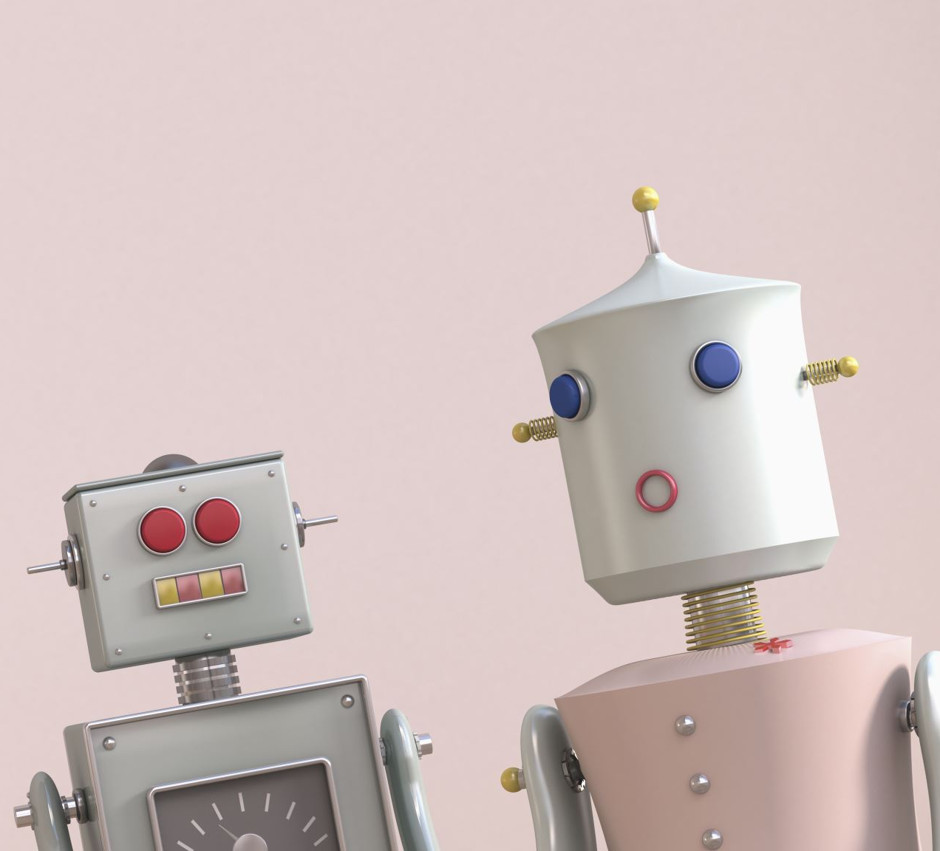
My Humility- and how I can relate to my Friends
Are my friends my friends so that I have someone to call to in my hour of need?
Do I give more or take more from my friends?
Am I there for my friends when they need my help?
Do I forsake my friends when I no longer need them for my own benefit?
Do I believe that I am more important than my friends?
How can My humility help me to become a better and more reliable friend, and expect less from others so that I do not burden them with my problems?
How can my Humility help me to become better friends with and rely solely upon my Creator for my needs and expectations through acknowledgement of my commitment in service to Him? How can this help me to appreciate the true friendship that others may have to offer me? How can this help me to become a better more reliable friend to others in their time of need?

Slide 32
My Humility- and how I relate to a stranger
Am I better than a stranger I meet on the street? Why do I think this? How do I know this? Do I know their story?
Would I be less likely to help a stranger who needs my help because I may never get anything back from them? Do I worship myself or our Creator?
How can my humility bring me to helping a stranger in need with altruistic kindness and become more grateful to my Creator?
How can my humility help me to better serve and worship my Creator through helping a stranger in need of my help?

Slide 33
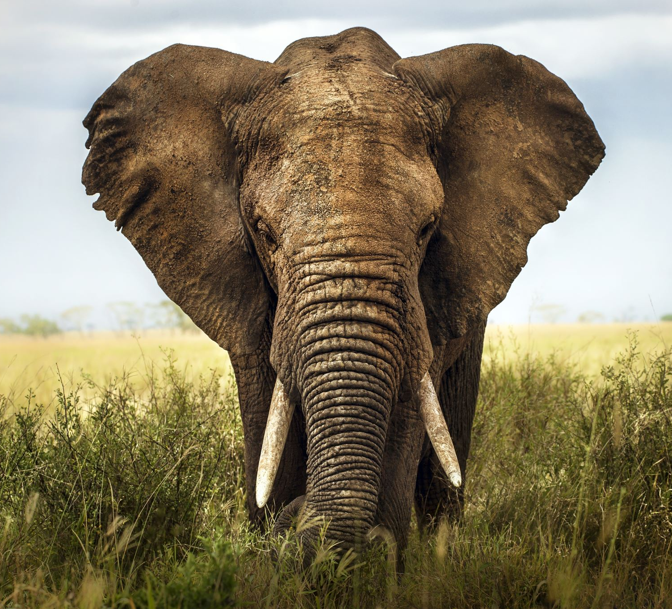
My Humility- and how I can relate to all creatures great and small
Who is greater than I? Is an elephant not greater than I? Who made me me and the elephant and elephant? How can my humility bring me to learn from other creatures and respect their life and treat them with kindness?
Who is greater than I? Is that what the ant says about me? How can my humility bring me to learn even from the smallest creatures through the realization that physical greatness is not what defines a spiritual being?
How can my humility lead me to respecting all creatures of life, great and small, through kindness and compassion in respect and awe for our Creator to Whom we all belong and return?

Slide 34
My Humility and how I can relate to the different worlds, the universe, and myself
Am I greater than the world in which I live? Is my world greater than the other worlds? Is my universe the only universe that exists?
Does the universe serve me or do I serve the universe?
Am I shaped by nature or do I shape nature from within me?
Does what I do or say have any impact on these outer worlds? Am I separate or one with my universe?
How can my humility help me to see the universe through myself and myself through the universe?
How can my humility help me to better serve and connect to my Higher Purpose and become One with a Will and purpose that is Higher than my Own?

Slide 35
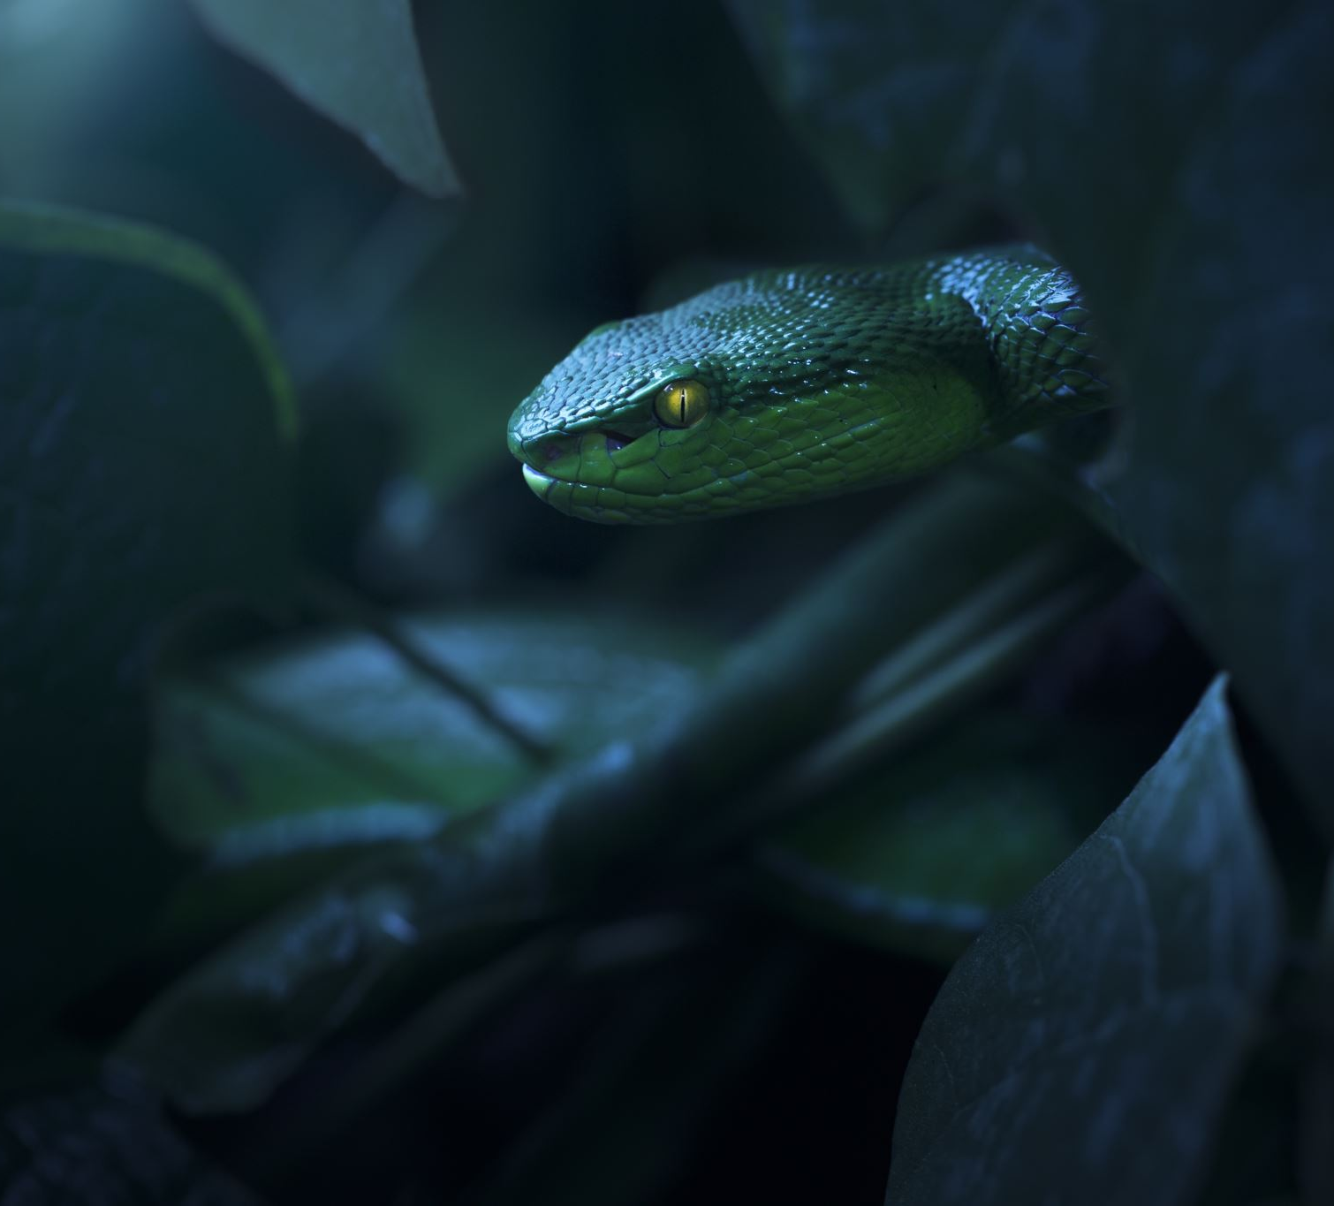
My humility and my evil inclinations
How can my humility help me to rise above my:
Ego
Lust
Greed
Envy
Sloth
Anger/vengeance
Fears
Sorrows
?
And become more able to serve my Higher Purpose and Glorify my Creator instead of serving and glorifying myself for my achievements and blessings that are given to me from Above?

Slide 36
How can my Humility bring me to Repentance?

Slide 37
My humility and my Gratitude
Can I be worthy and grateful at the same time? If so- how?
Am I more or less grateful when I feel my own importance and value? Who am I grateful to- myself?
How can my humility help me to maintain my gratitude to that which is Above me during times of hardship and ease?
How can my humility help me to persevere in expressing my gratitude to my Creator through sharing of my blessings with those who have less than I do without expectation of return?

Slide 38
My humility and my Forgiveness
Am I more or less able to forgive others when I do not value their importance at the same level or above my own?
Am I more or less likely to be able to forgive and pardon the faults of others when I do not remember or feel ashamed of my mistakes?
Am I more or less likely to seek and recieve forgiveness from my Creator when I am not able to forgive or pardon others’ faults?
How can my humility help me to become more forgiving of others, and more worthy of forgiveness for my own faults?
How can my humility help me to better appreciate the value of repentance so that I can take responsibility of my speech and behavior, mend my ways and serve a Higher Purpose other than that of my own?

Slide 39
My humility and my Patience
Can I be humble and angry at the same time? Why am I angry? Am I worthy of controlling others around me and what tomorrow will bring?
How can humility teach me how to become more patient with others and in the face of hardship and struggle through allowing me to let go of the need to control others, and time, through seeing and respecting their importance as the same or higher than my own?

Slide 40
My humility and my Compassion
Can I become truly compassionate without humility? How can I understand and empathize with another creature without seeing their soul, without hearing their cry for help, without feeling their pain?
How can see, hear and feel in a dimension that is Higher and Above myself without nullifying myself to the point of realization that I am next to nothing compared to You? And that without You I am nothing?

Slide 41
My humility and my Kindness
Can I be truly kind without my humility?
Is forgiveness and a kind word not better than charity followed by injury?
Can I be truly humble without being kind? Is not my purpose to express my humility through my kindness? Otherwise what is the point of my humility?
How can my humility bring me to a Higher understanding of and ability to express my Kindness and help me to express my kindness in a way that serves a Higher Purpose other than my own?

Slide 42
My humility and my Love
Can I become truly humble without my Love? Can I truly love without my humility?
What bring me more Pleasure?- to be loved by You or to love You?
Do I love myself more than I love You? How can I serve You if I serve myself? How can I be me without You? And how can I better know You without allowing myself space to be me?
How can we have a relationship in a peaceful Home without the the both of us? So how can we have a relationship without separation? And How can we enjoy the pleasure of uniting if we are not separate?
How can my humility help me to reach a Higher form of my Love and my expression and acceptance of unconditional Love?
How can my humility help me to see me in you and you in me while allowing you to be You and me to be Me so that we can have a more meaningful relationship and better serve our Creator?
How can my humility help Us to have a better connection with our creator so that We love and serve our Creator with Our hearts minds and strength and do not worship ourselves or one another before Him?
How can my humility help us Unite with our creator in our unconditional selfless love for our Creator and for one another?

Slide 43
My humility and my Justice
How can I become more Just without my humility? How can I be truly humbled without Justice?
How can a kingdom be protected from its enemies without justice? How can I rule my own kingdom without protecting myself from my evil inclinations? Am I able to do this by myself? Can my own mind and intelligence protect me from myself? How can humility help me accept Mercy and help from that which is Above me in order to protect my kingdom from destruction?
How can Justice bring me to humility? Am I not humbled when I am punished for my evil deeds?
How can my humility bring me to realize that Justice is a kindness from that which is Above me in order to bring me towards becoming more Just?
Am I more or less likely to humble myself before a King that is Just or unjust? How can Justice from Above me bring me to humility before my King? How can Justice help me become a more obedient servant?
Can I love that which I fear? Can I fear that which I love? How can my humility help me to feel both Awe and Love for the Higher Justice which I once feared- through obedience and surrender to a Higher Will above my own understanding?
How can my humility enable me to remain in the path of pursuing justice towards others through reminding me of their importance being equal to or higher than that of my own?
How can I learn to become more Just without connecting to a Higher Justice- the source of my justice through my humility?

Slide 44
My humility and my Truth
Can I seek and find Truth without my humility? Can I become more humble without seeking Truth?
How can I seek truth without asking myself questions? How can my life experiences which cause me to become broken and humbled direct me to seeking a Higher Truth?
What would be the point of seeking more Truth if I already know everything? How can humility help me reach a Higher Truth through emptying myself of that which I already know?
How can my humility help me to maintain my path of seeking truth through expressing more gratitude for that which I learn from Above me, by sharing that which I have with those who have less?
How can my humility help me to understand the importance of revealing the secrets of my truth with others through loving for others what I love for myself and understanding that nothing that I have learnt of Truth actually belongs to me? And that I am not the Source of my Truth and therefore not worthy of its gratitude?
How can my humility help me to serve my Creator and humankind through becoming more truthful in my thoughts speech and action? How can this help to improve my relationships with others and become more trustworthy and faithful to my Creator and those that I love?

Slide 45
My humility and my Hope
How can I be hopeful without being humble? What would be the purpose of hope if I could not become better than I already am? What would be the purpose of hope if I could not help you become better than you already are?
How can I be humbled without any hope? Would that which broke me not completely destroy me if it were not for my hope?
How can my humility bring me to hope in my salvation and that of others through seeking forgiveness from my Creator-having Faith in His Kindness and compassion and feeling regret for my sins so that I can mend my ways with the hope of becoming better than I am this moment?

Slide 46
My humility and my Joy
Can my humility bring me to my joy? How can I be humbled without hardship and suffering? How can I feel joy if I am in pain and in sorrow?
Am I able to find joy in the wisdom that I find through my negative experiences in my life? How can my humility allow me to see the hidden treasures within the darkness of my soul and see every event in my life as an opportunity to grow from and get closer to knowing You?
Can I find joy in my brokenness that humbles me and therefore opens the doorway which leads me to my Creator?
How can my joy in my humility help me maintain my humility through discipline and self reflection and prayer and charity and help me directly connect to my Creator?
How can my joy in my humility help to give me the strength to persevere in acts of loving kindness so that I can have a more meaningful relationship with others?

Slide 47
My humility and my Peace?
How can I find my Peace without my Humility? How can I radiate my Peace unto others without my humility?
How can I become more humble without seeking Peace? How can I inspire humility in others without seeking to make peace between others?
Does my anger and despair not lead to chaos and destruction both within and around me? Why am I angry? Why do I despair? Why do I fear? Is this led by my own ego and doubt in my Creator? How can arising above my ego through my humility and surrendering to the Will of that which is Higher than Myself- help me to better control my anger and despair and fears and doubts so that I become more able to calm the storm that is both within and surrounds me or maintain my Peace despite the chaos?

Slide 48
How can I Become more Humble?
Have I tried…
-Seeking Truth- through questioning, seeking knowledge wisdom understanding and love, with an honest and sincere heart?
-seeking humility from that which is Beyond me through disciplined prayer and self reflection/meditation?
-Considering that if hardship and struggle can lead me to humility that this too is a blessing in disguise?
-Actively and consciously going against my ego by reminding myself as much as possible of that which is Above me, the Source of me. Allowing this to be the driving Force of my thought speech and action- ie to serve a Higher purpose, even if it goes against my worldly desires which only serve myself (lust, sloth, greed, envy, anger, ego, vengeance)
-Turning to my Creator directly and Seeking His Forgiveness for all my past sins (deeds which were driven by my own ego to serve my own purpose) while allowing myself to forgive all that have wronged me and continue to wrong me?

Slide 49
How can I Become more Humble?
Have I tried…
Treating others how I myself would want to be treated?
Judging myself before judging my fellow human’s status? Taking the plank out from my own eye before attempting to remove the dust from my fellow’s eye?
Practicing what I preach? Fulfilling my vows and commitments? Speaking the truth, while seeking Peace always?
Performing more acts of loving kindness and charity- going beyond myself and my own needs and wants to help my fellow human achieve his or her needs and wants?

Slide 50
Is my humility able to help me transform me into that which serves my Higher Purpose?
What does success mean to me?
How do I achieve my Success?
Is my success in the success of others? Or does it exclude others?
Is the success of others also my own success? Or am I excluded?
Am I successful when I help others to achieve the same success that I strive for? Am I even able to achieve my own success without my success becoming the success of others? – if not- then how can I transform into something that is Higher than me through my humility? Should my humility not bring me to love for my neighbor that which I love for myself? Should my humility not bring me to sacrifice myself for You? Should my humility not bring me to a State of Higher unconditional Love?- A Home of Peace?
Once I have attained my own success through your success- am I able to recognize that it was not Me that is worthy of gratitude- but my Creator who created me that is worthy of all Praise, Honor and Glory? Can my humility bring me to this level of worship and service to that which is Above me so that even if I transformed into nothingness in order to serve my Higher purpose- it would not matter to me?
Can my humility bring me to the willing self sacrifice of myself for You? Or at least to place that is near this- in order that I can maintain my identity as nothing more Your Servant so that I may continue to worship and Glorify Your Name?
For how can I become more righteous if I am not human? How can I be me without You? So what is the purpose of my righteousness if not for You? Is not everything already Yours? Do I not belong and return to You?
Can my humility bring me to understand that even my free will does not belong to me but to my Creator and so to His Will I willingly surrender my own will so that His Will be done on earth as it is in Heaven through me?

Slide 51
My humility
How can my humility bring me closer to living in a world full of:
Peace, Justice, Truth and acts of loving kindness?

Slide 52
Can my Humility bring me closer to You?
All Praise and thanks belong to our Creator- Lord of The Worlds

