Slide 1
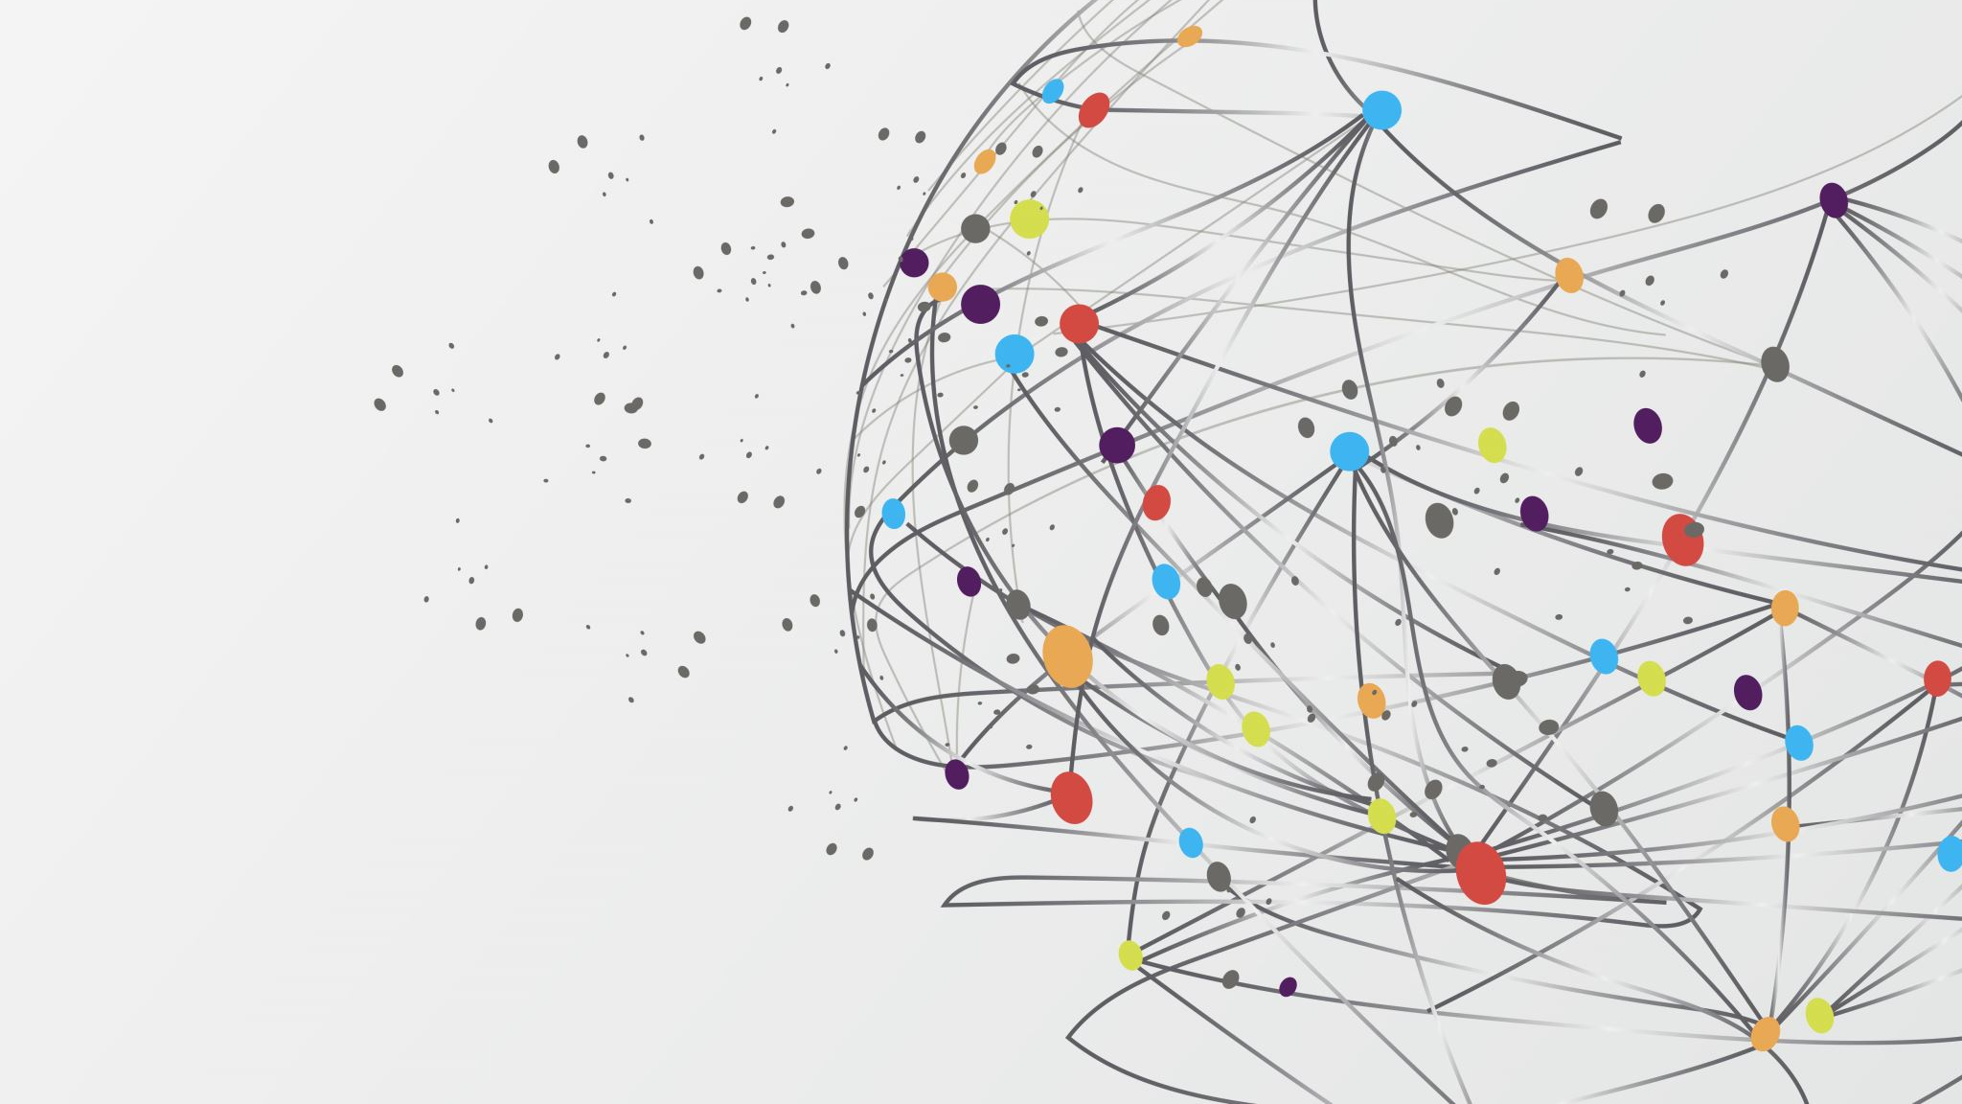
Anger
(Consultation to be led by someone who has had anger management difficulties in the past- but has managed to ‘transform themselves.’)

Slide 2
My anger
What makes you angry?
How difficult do you find it to control your anger levels?

Slide 3
My anger
Can you think of any recent events that made you angry?
What happened?
How did you react?
How did this event/s affect your relationship with someone else?
What emotions do you now feel towards that person/people?

Slide 4
My anger
How does your anger affect your reaction to others in general?
How do you think it makes them feel and why?

Slide 5
My anger
Do you ever feel remorse after reacting to a situation in a way which then causes hurt to another because of your anger?
How do you act after you feel remorse- do you apologise and take responsibility or do you find this difficult to do? If so- why?

Slide 6
My anger
What emotions do you feel when someone gets angry with you?
Can you think of any times when someone misunderstood your intentions and got angry with you? How did this make you feel?

Slide 7
My Anger
Can you think of any events for which you feel no remorse about your anger?
Do you feel you must always be ‘right?’- If so how do you think this makes the other person feel?
Can you think of any situations where you felt you were being ‘judged’ by others?- How did this make you feel?
Would you say that you are Judgemental?

Slide 8
My Anger
Do you ever feel like a ‘victim’ in a situation which makes you angry?

Slide 9
My ANGER
Do you like to be in ‘control’ of the behaviour of others?
Do you like to be in control of situations?
Are you in ‘control’ of your past? Your future?
Are you in control of your present? How?
Are you control of your ‘anger?’

Slide 10
How do the following emotions affect your anger levels: Pride Envy Greed/ desire for wealth and power Lust Desire for Vengeance Hatred Selfishness
MY ANGER

Slide 11
‘Their’ anger towards me
How often do others get angry with you?
What makes them angry do you think?
Do you feel misunderstood?
Do you feel ‘not listened to?’
Do you feel others pass judgement without right?
Do you feel others fail to ‘understand’ your circumstances?
How do you feel when others ‘express’ their anger towards you?

Slide 12
’Their’ anger towards me
Is there anyone in your life who you think is angry with you?
Why are they angry?
On reflection- have you said or done anything that upset them? If so- what emotions led you to this? Were you angry?
How has this affected your relationship?
What have you learnt from this?

Slide 13
What has helped me?
Have you ever turned to alcohol and intoxicants to help you with your anger management? Has it helped in the long run?
Have you tried medication to control your anger? How has it helped?
Have you had any ‘anger management therapy’ in the past? How has this helped?

Slide 14
What has helped me?
How does my love empathy for others influence my anger levels?
How does my ability to forgive and pardon others affect my anger levels?
How does my ability to ‘respect’ the right of others affect my anger levels?
How does my humility help me with my anger levels?

Slide 15
Am I in Control?
What behaviour of others helps you feel less angry towards them after they say or do something ‘wrong’ in your opinion?
How much of others’ behaviour is in your control?
How do you feel when others (in your opinion) try to ‘control’ your behaviour?

Slide 16
Reflecting on my anger
Based on your reflections- How well do you think you ‘treat others how you would want to be treated?’
Based on your reflections- How much of your anger stems from your desire to ‘control’ others or situations?
How much of your anger stems from the need to be ‘right?’ and win an argument?

Slide 17
What else can I try?
Seeking ‘Truth’ or to learn from the other perspective rather than trying to ‘win’ an argument

Slide 18
What else can I try?
Stay true to your purpose, and who you want to become, while showing respect others’ choices and opinions

Slide 19
What else can I try?
Surrender to a Higher Purpose
Humility- acceptance that we are not ‘in control’ or self sufficient- trusting in a Higher power than ourselves
and letting go of the need to control others or situations- Let it ‘be’. Not letting the past control our present and future behaviour.

Slide 20
What else can I try?
Forgiveness- for all those that have wronged us from our opinion
Faith that we ourselves are worthy of forgiveness- as long as we ‘learn’ from the past and mend our ways…
Repentance

Slide 21
What else can I try?
Respect for others and their ‘rights’ of opinion and belief

Slide 22
What else can I try?
Courage- Not being afraid to be ‘wrong’- admitting when we have done something wrong, not being afraid of rejection or failure

Slide 23
What else can I try?
Empathy- listening more to other’s perspectives- putting ourselves in their shoes

Slide 24
What else can I try?
Kindness/ Mercy/ Compassion- Repaying evil with good (even if very difficult to do)

Slide 25
What else can I try?
Divert the negative ‘anger’ energy into something that helps humanity- Justice- stand up against oppression of the needy/poor/impoverished and injustice to the best of your ability
Find alternative ways to ‘release’ the negative anger energy in a way that causes no harm to others or your relationships

Slide 26
What else can I try?
Turning away from ill-speech and behaviour of others that incite anger- walk away in peace if posible from a negative space to a positive one

Slide 27
What else can I try
Less about ‘me’ but more about ‘others’. Wish well for others’ success and happiness.
Taking responsibility for our own speech and behaviour instead of playing the ‘victim.’
Try to overcome feelings of envy/lust/greed/ego

Slide 28
What else can I try?
Regular prayer/meditation
self reflection
Charity
Fasting
This may be difficult at first but getting into a discipline with it can help….

Slide 29
What else can I try?
Listening to others more, seeing things more from their perspectives

Slide 30
What else can I try?
Try avoiding:
-intoxicants: they can prevent us from thinking clearly and make us more likely to ‘lose’ control of ourselves, and get angry
-backbiting/slander/gossiping

Slide 31
What else can I try?
Perseverance- Keep trying- don’t give up hope

Slide 32
Transform and help to transform others
Using our negative experiences of the past to transform into positive actions that can help others

